Slide 1
Rover Software
Mission to Mars

Slide 2
What is FTC SDK?
Official programming framework for FIRST Tech Challenge
Written in Java and runs on Android phones
Provides:
  OpModes for control
  Access to hardware
  Telemetry for debug output
Think of it as the “default engine” to run your robot.

Slide 3
What is FTCLib?
An open-source library built on top of the FTC SDK
Inspired by WPILib (used in FRC)
Encourages modular, reusable robot code
Provides:
  Subsystems
  Commands
  Controllers (PID, Feedforward, etc.)
Why use FTCLib? Cleaner code, better structure, easier debugging.

Slide 4
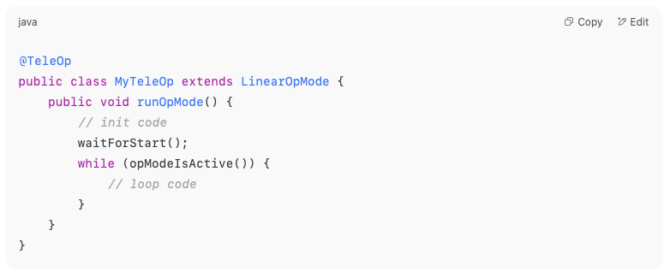
OpModes – The Starting Point
An OpMode is the main entry point for running your robot
Two types:
  TeleOp (manual control)
  Autonomous (pre-programmed actions)

Slide 5
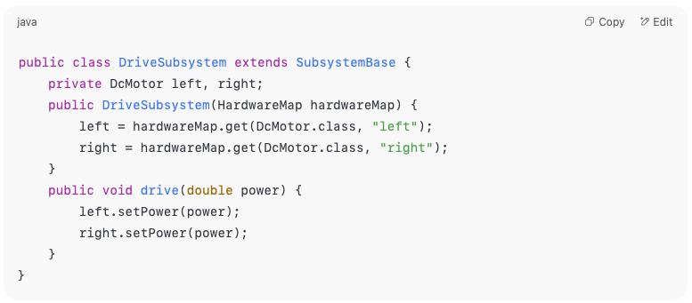
Subsystems – Organize Your Robot
A Subsystem represents a part of your robot (e.g. drivetrain, arm, intake)
It holds hardware references and low-level methods

Slide 6
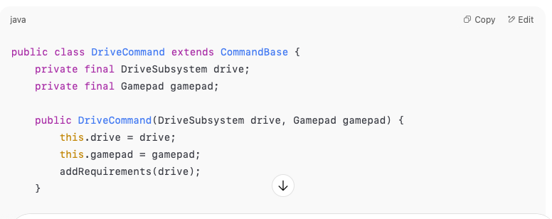
Commands – Tell the Robot What to Do
A Command uses a Subsystem to perform an action
Can be:
  Run continuously (e.g., drive while joystick held)
  Run once (e.g., lift arm)

Slide 7
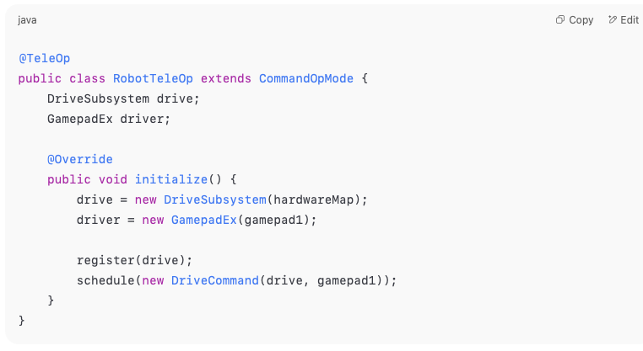
Putting It All Together

Slide 8
Benefits of Using FTCLib
Clean separation of logic
Easy to test and modify subsystems independently
Encourages good software engineering practices
Scales well as your robot gets more complex

Slide 9
Resources and Next Steps
FTCLib GitHub: https://github.com/FTCLib/FTCLib
FTC SDK Docs: https://ftctechnh.github.io/ftc_app/doc/
M2M Source: https://github.com/acearun/MissionToMars
Practice:
  Turn your drivetrain into a subsystem
  Write a command for joystick control
  Try using CommandScheduler

Slide 10
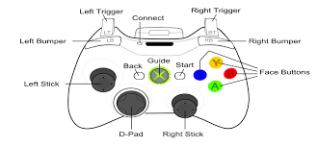
Controller Layout

Slide 11
Exercise
Add a second motor and have its motion be controlled by the Left Joystick

Slide 12
Exercise
Complete drivetrain build
Try Differential Tank & Arcade drives
Practice for runs

